Slide 1

Course Flow
Under Supervision DR. Basem Elhady
Scheduler & Recommendation system

Slide 2
Team members
Lamis
Mahran
Rewan
Amr
Merna
Osama
Riham Mahmoud
Shrouk Elsayed

Slide 3
TABLE OF CONTENTS
01
Abstract
04
Course flow Parts
02
Related Work
07
Conclusion
05
Tools and Technologies Used
03
06
Future work
Problem Statement & solution

Slide 4
01
Abstract

Slide 5
Abstract
IN today's era of technology, nearly everything has shifted online.
From education to jobs, various other aspects of modern life have transitions to digital platforms.
As its common to utilize platforms like Udemy and Khan Academy for studying.
Course Flow is designed to assist educational institutions in manage and display their course schedules.
It also aids recommend similar courses on Udemy for which the user is searching for.
Speech-to-Text has been integrated into the recommendation system by allowing users to search for courses using voice commands.

Slide 6
02
Related work

Slide 7




Inspired by
Udacity
edx
Khan Academy
Udemy

Slide 8
03
Problem statement

Slide 9
What is the problem?
-It would typically outline the challenges and issues that the system aims to address.
-Here's a generic example:
Many educational institutions face challenges in managing and optimizing the flow of courses.
Current systems often lack efficiency, transparency, and adaptability, leading to difficulties in course scheduling & resource allocation.

Slide 10
03
Problem solution

Slide 11
Here are key components of a potential solution:
Integrated Course Management Platform.
Scheduling and Resource Allocation.
User-Friendly Interface.
Data Analytics and Reporting.
Scalability and Future-Proofing.
Security and Privacy.
By addressing these components, the proposed solution aims to optimize course management, enhance user experience, and contribute to the overall efficiency of the educational institution.

Slide 12
04
Course Flow parts

Slide 13
Course Flow parts
Admin side
01
Student side
02
AI Course
Recommendation & Speech-to-Text
03

Slide 14
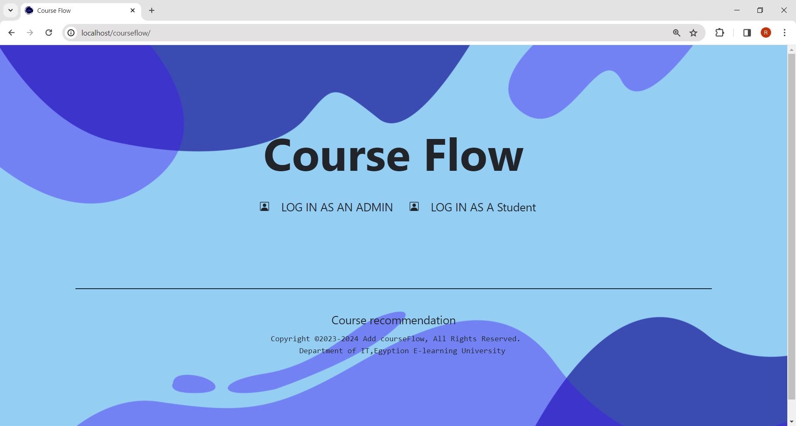
Home

Slide 15
01
Admin Side

Slide 16














Admin Side
Login
Add Course
Courses
Edit Profile
Approve & Reject
Schedule

Slide 17
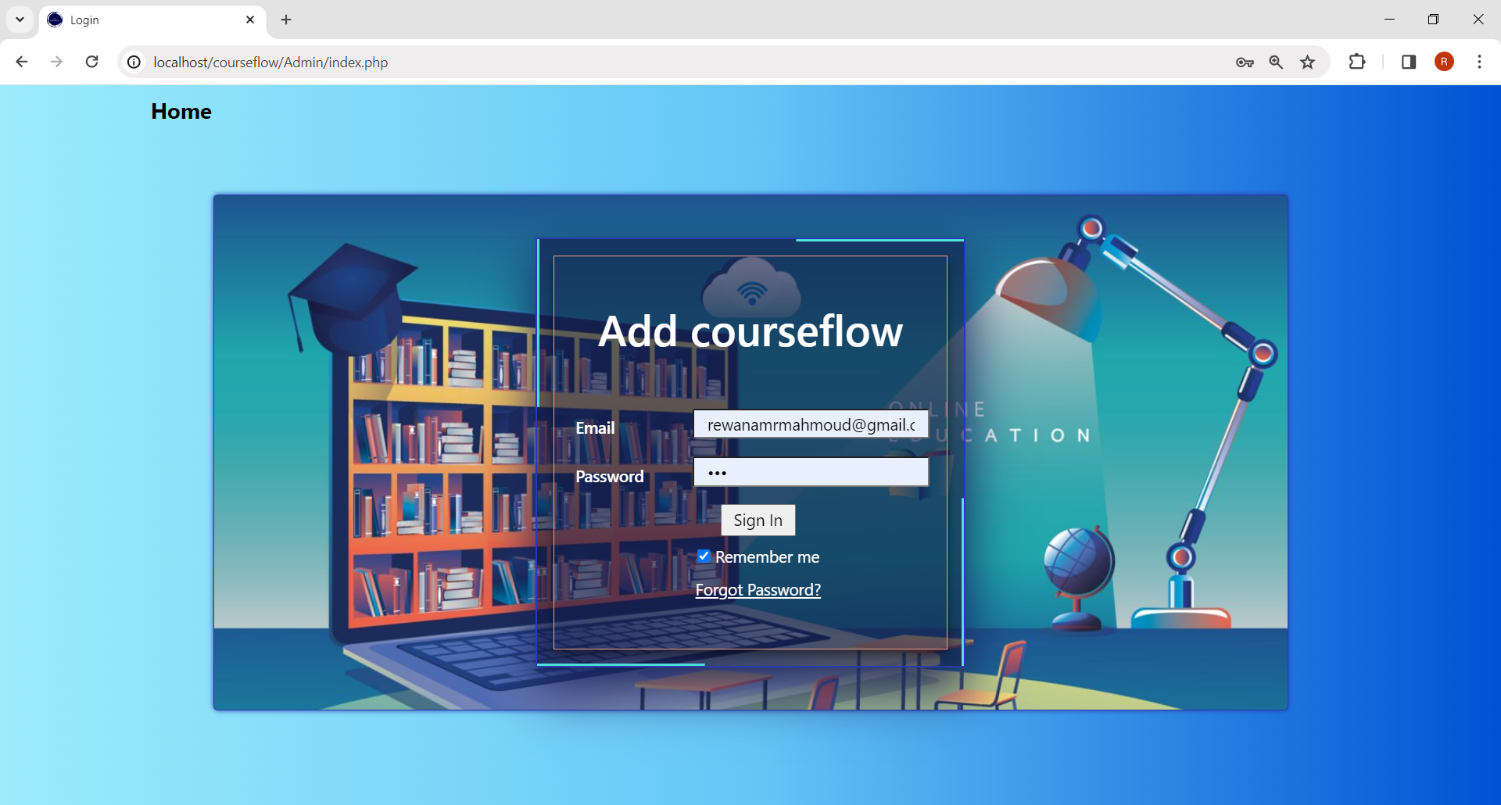
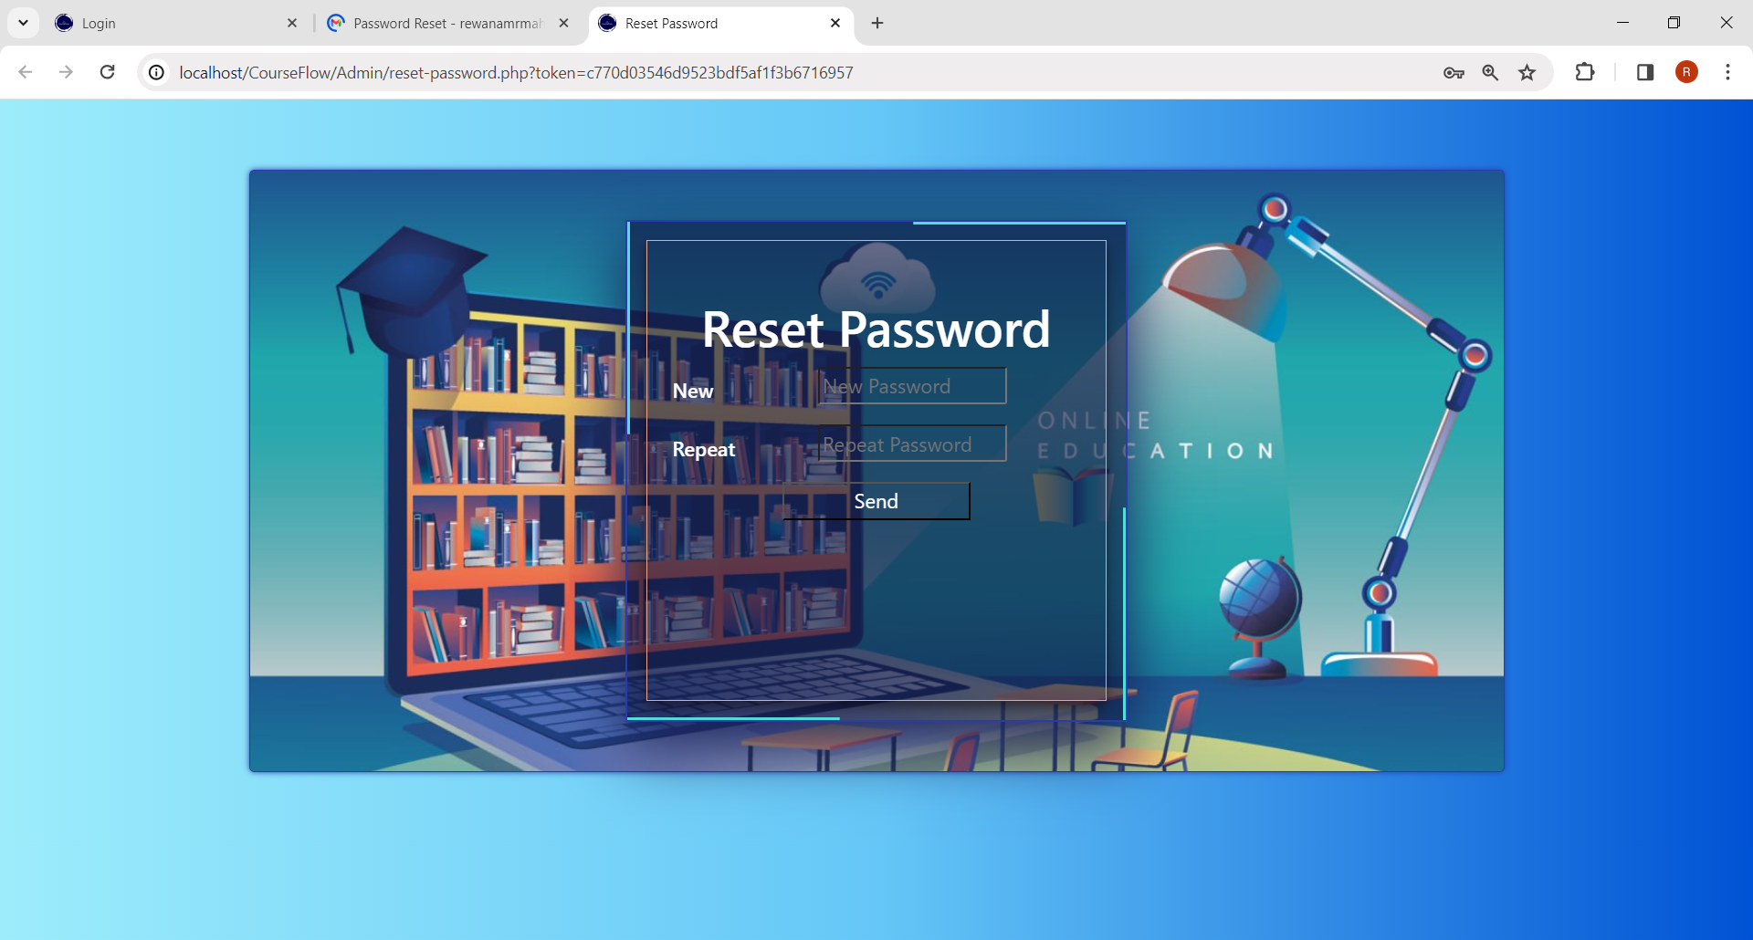
Admin side(cont.)
1.Login form
Login Credentials
Password Reset Functionality

Slide 18
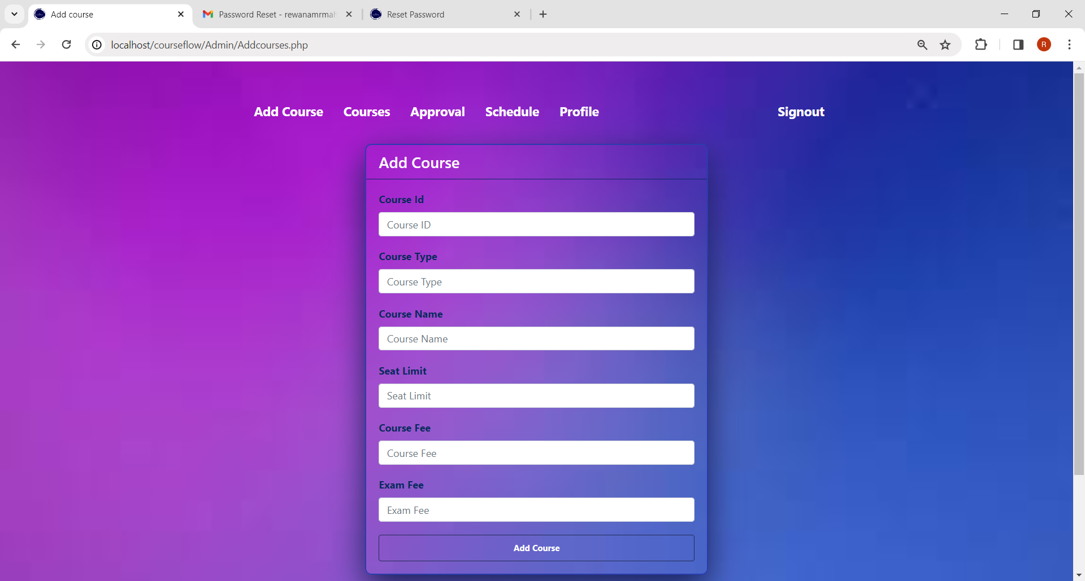
Admin side(cont.)
2.Add Course

Slide 19
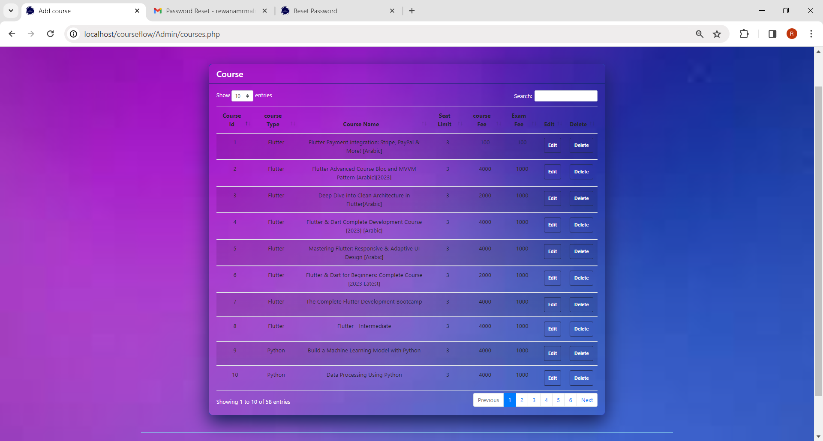
Admin side(cont.)
3.Courses

Slide 20
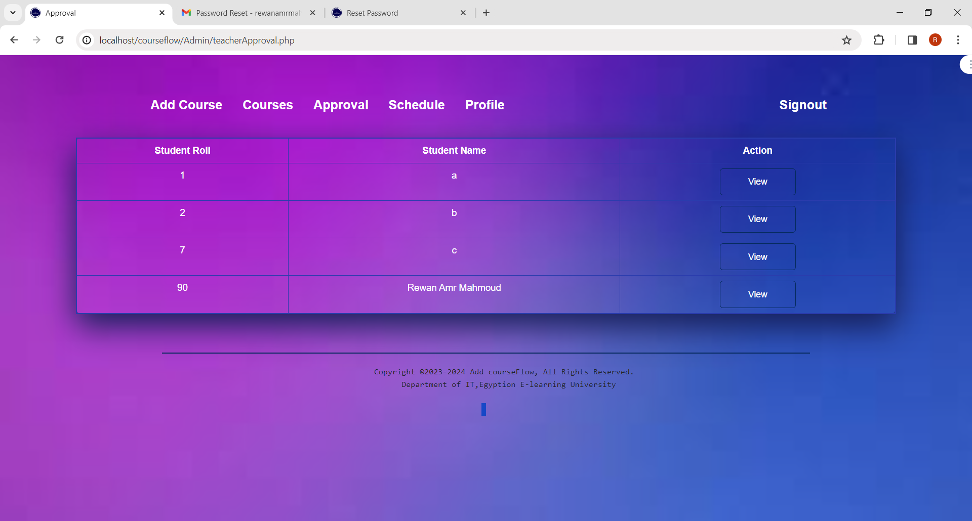
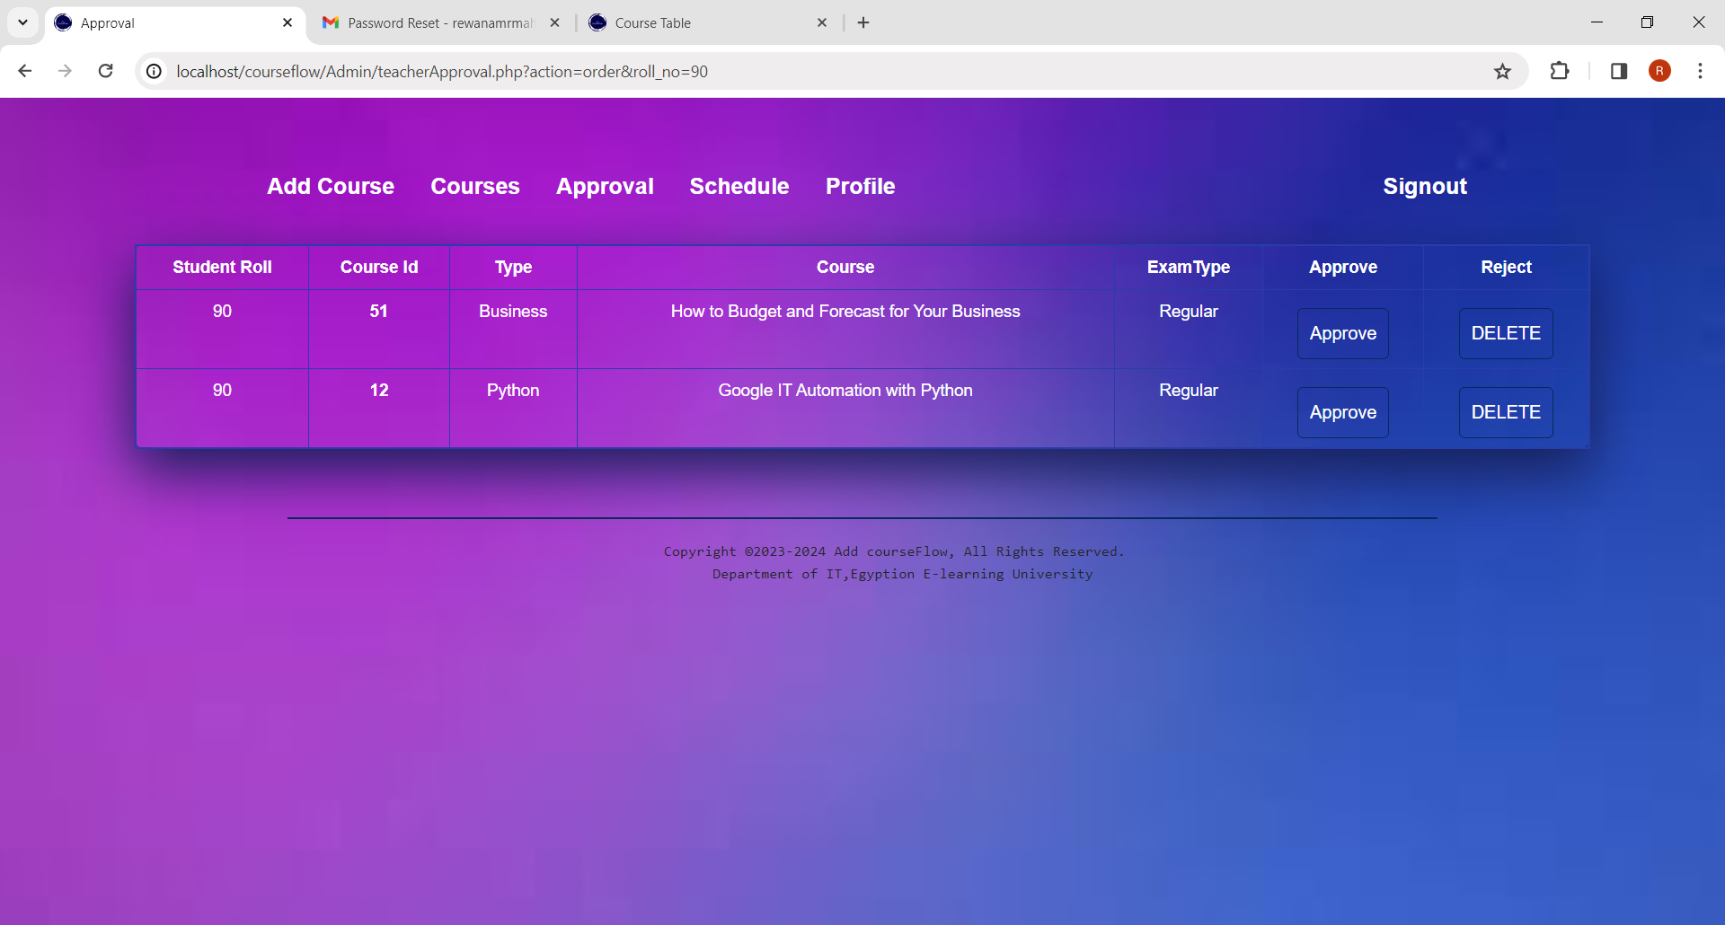
Admin side(cont.)
4.Approval

Slide 21
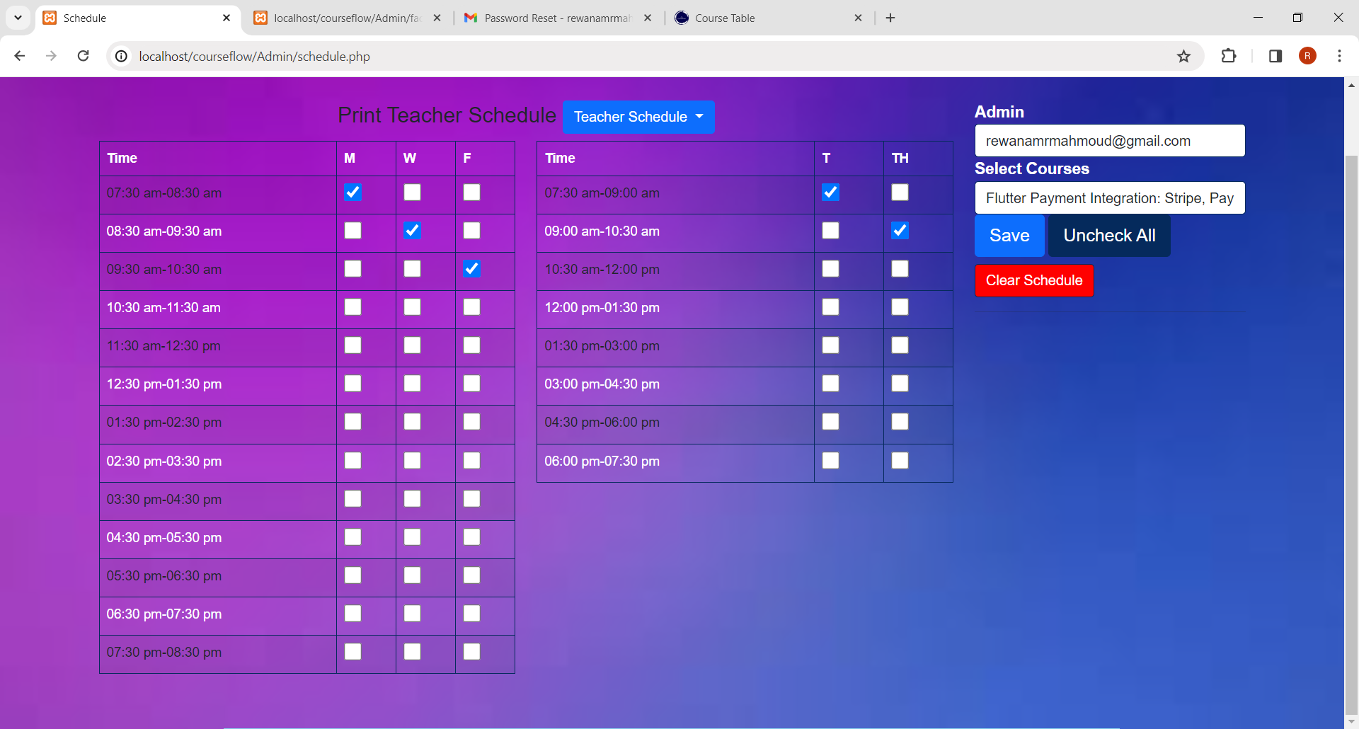
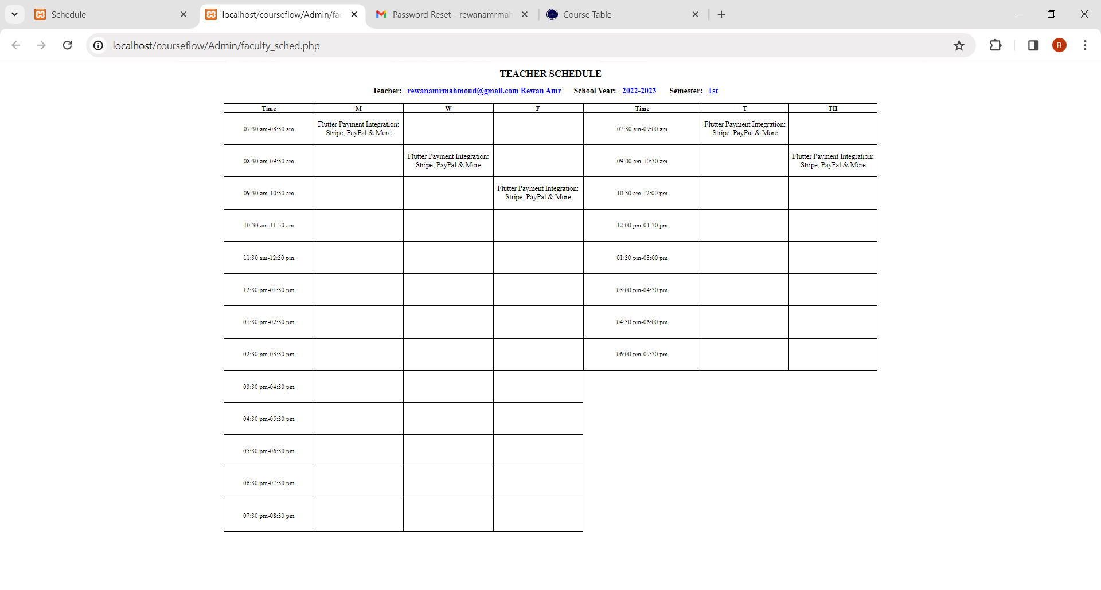
Admin side(cont.)
5. schedule

Slide 22
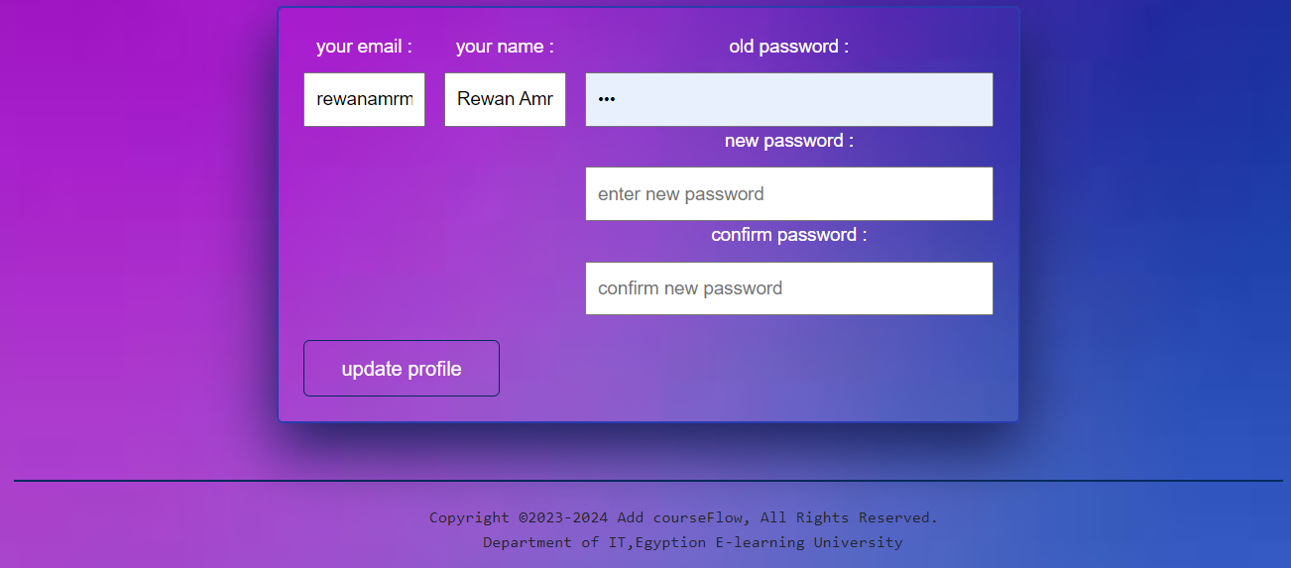
Admin side(cont.)
6. Edit profile

Slide 23
02
Student Side

Slide 24
Student Side
Select Course
Pending Courses
Approved Request
Schedule
Edit Profile
Registration & Login Form

Slide 25


Student side(cont.)
1.Registration & Login form
Login Credentials
Password Reset Functionality

Slide 26
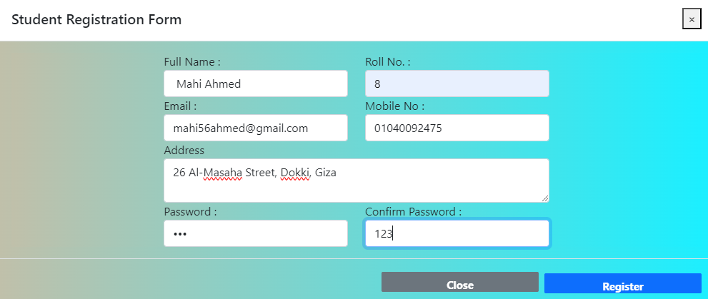
Student side(cont.)
1.Registration & Login form
Registration Credentials

Slide 27
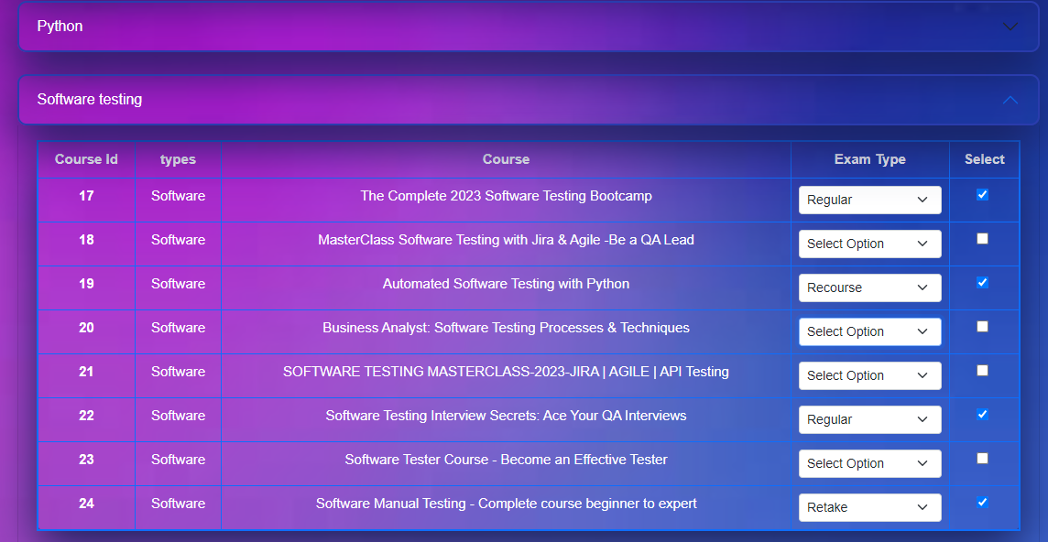

Student side(cont.)
2.Select Course

Slide 28
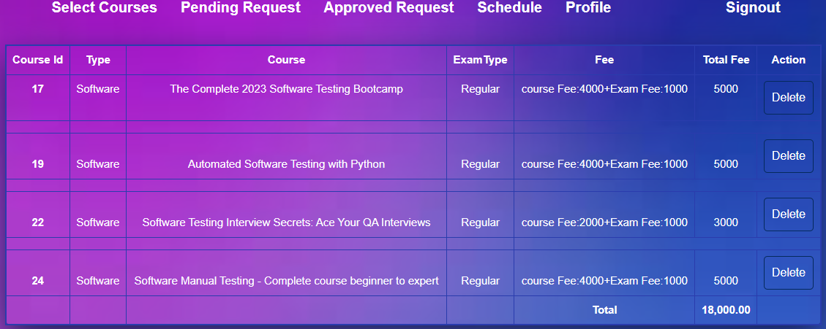
Student side(cont.)
3.Pending Courses

Slide 29
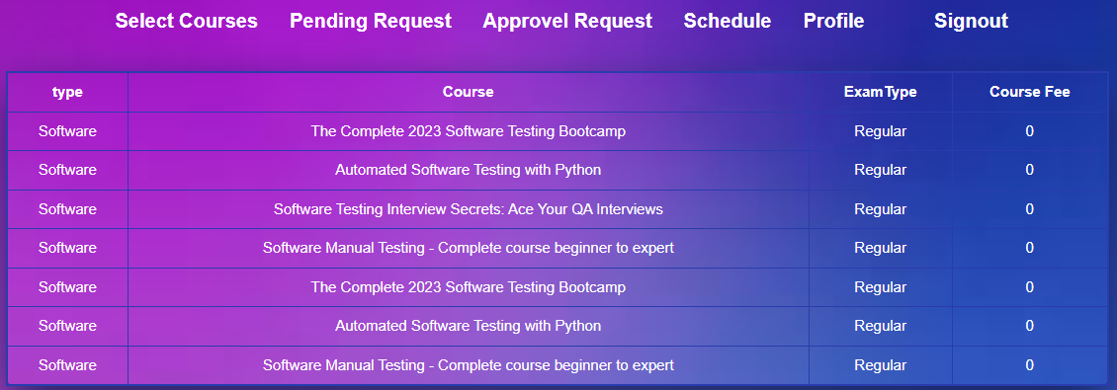
Student side(cont.)
4. Approved request

Slide 30
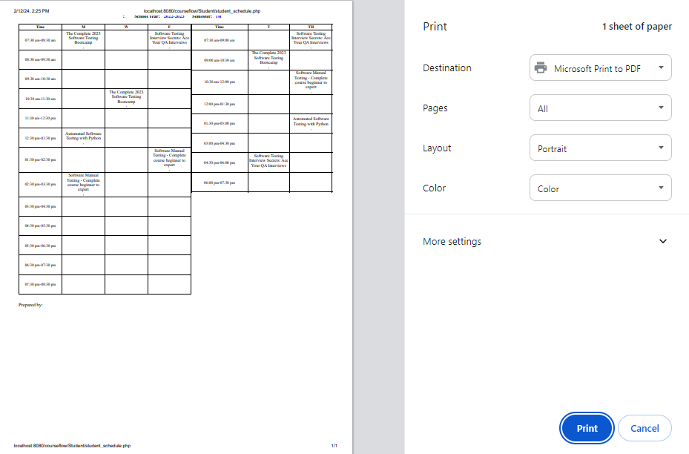
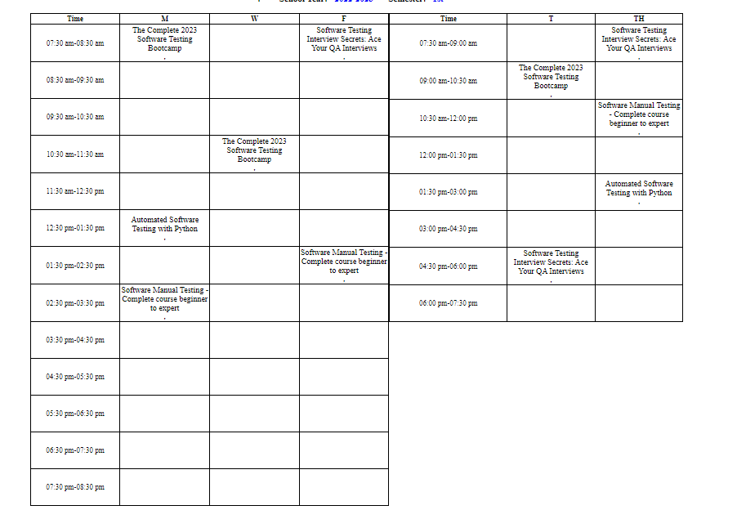
Student side(cont.)
5.Schedule

Slide 31
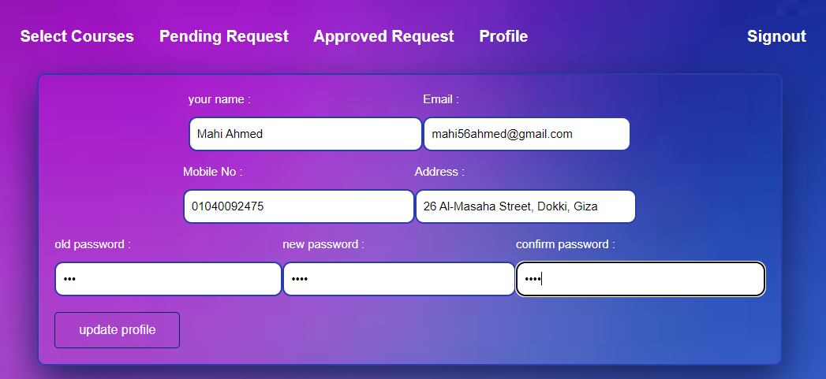
Student side(cont.)
6. Edit profile

Slide 32
03
AI course recommendation

Slide 33
AI course recommendation
Search-based recommendation system
01
Present Work
02
Speech-To-Text
03

Slide 34
Search-based recommendation system
This feature helps recommend similar courses on Udemy for which the user is searching for.
User Input
Search Algorithm
Ranking Algorithm
Display Results

Slide 35
Present Work
DATA SET
01
02
ALGORITHMS
03
Exploratory Data Analysis

Slide 36
01
Data Set

Slide 37
Data Set
01
Data Source
a
Data Description
b
Data Preprocessing
c

Slide 38
a
Data Source

Slide 39
Data Source
• This dataset contains 3734 records of courses from 9 subjects (Business Finance, Graphic Design, Musical Instruments and Web Design/Development-IT&software-Office productivity-Personal development-Marketing) taken from Udemy.
• Anybody can create a course, a business model by which allowed Udemy to have hundreds of thousands of courses.

Slide 40
b
Data Description

Slide 41
Data Description
• When the data used in this study was first obtained, it consisted of 3734 observations across eighteen variables.
• The remaining 18 variables in this dataset were treated as predictors in each of the classification models.
• for example course_id, course_title, is_paid, price, num_subscribers, num_reviews, num_lectures, level, content_duration, published_timestamp, subject, profit, published_date, published_time and year

Slide 42
c
Data Preprocessing

Slide 43
Data Preprocessing
For building the course recommendation system, we will be working with only the course_title column only.
We start by cleaning the course_title using neattext.functions column as it is a text data.
list all the methods present in the neattext function
Remove stop words &# Remove special characters
Vectorize clean_title column Text Vectorization is the process of converting text into numerical representation.

Slide 44
02
Algorithms

Slide 45
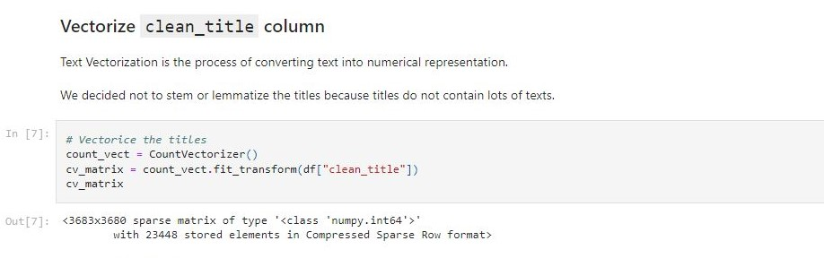
TF-IDF (Term Frequency-Inverse Document Frequency)
The TF-IDF algorithm is a statistical measure.
It used to evaluate the importance of a term within a document relative to a collection of documents.
It used to vectorize the text data and represent each course title as a numerical feature vector.
It is commonly used in natural language processing and information retrieval tasks.
such as search engines, text mining, and recommendation systems.

Slide 46
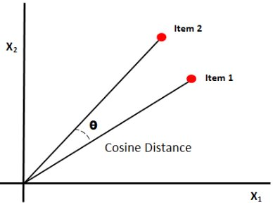
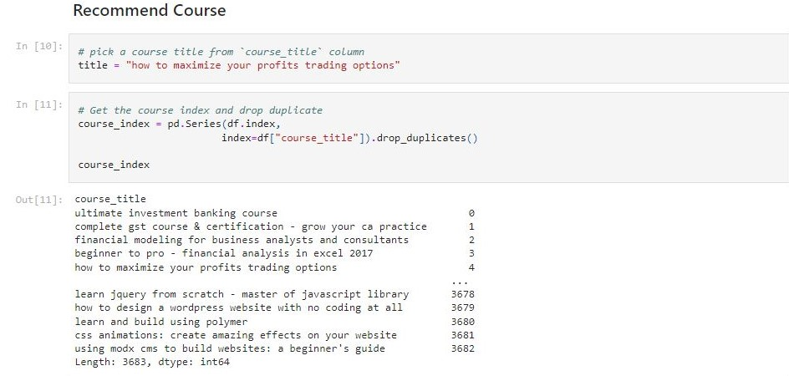
Cosine Similarity
Cosine similarity measures the similarity between two vectors of an inner product space.
It is measured by the cosine of the angle between two vectors and determines whether two vectors are pointing in roughly the same direction.
It is often used to measure document similarity in text analysis.
Higher similarity scores suggest that the courses are more similar, while lower scores indicate less similarity.

Slide 47
03
EDA

Slide 48
EDA : Questions to solve
Courses title
Duration of courses
Subjects & categories
Subscribers
Published year
Correlation
Levels
Price

Slide 49
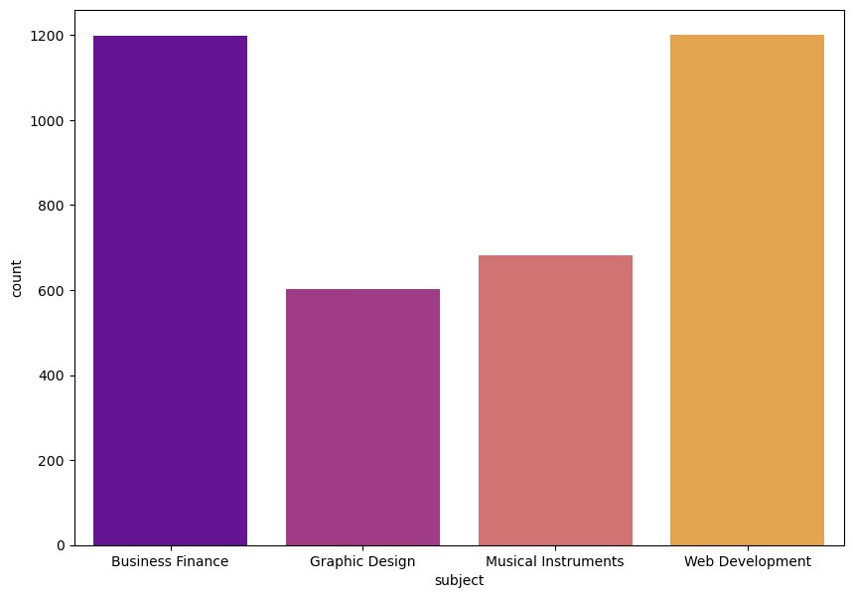
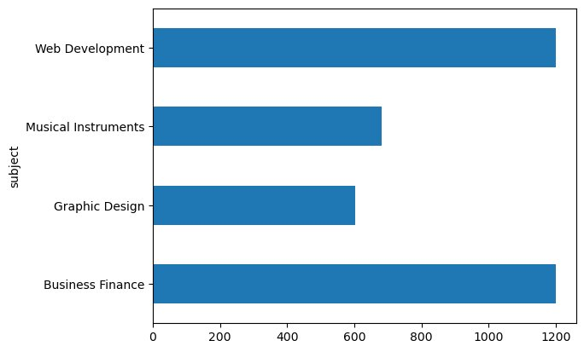
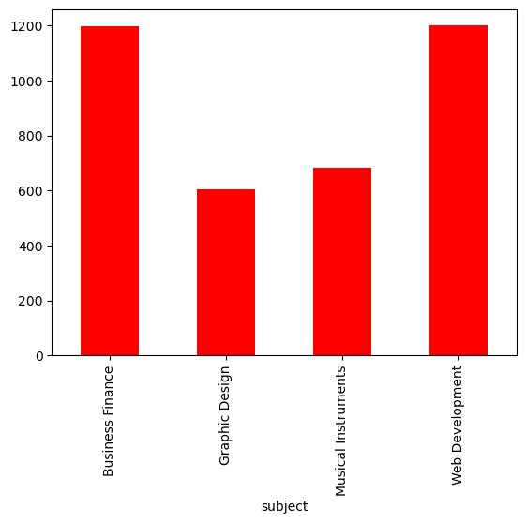
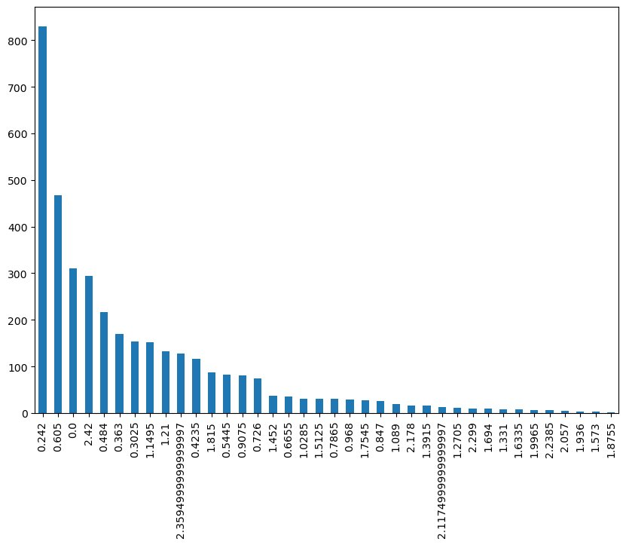
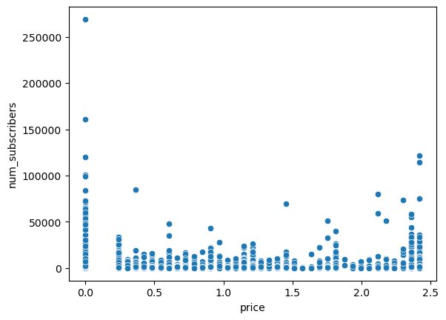
EDA (cont.)
EDA on Subject/Category
EDA on Subscribers
EDA on levels
EDA on price
EDA on correlation

Slide 50
Speech-To-Text
Brief
01
02
Algorithms
03
Integration

Slide 51
Brief overview
Enhanced Accessibility
Advanced Search Capabilities
Improve User Experience
Future-Proofing
Efficiency
Course Discovery
Inclusivity
Reduced Effort for Users

Slide 52
02
Algorithms

Slide 53
Algorithms
1. Frontend (JavaScript - Speech Recording and Uploading):
Requests microphone access
Records audio using Media Recorder object.
Audio data captured in chunks and stored
Upon recording stoppage.
Audio file appended to Form Data object and sent via POST request to Flask server at "/process" endpoint.
Upon server response, corrected text displayed in input field.
2. Backend (Flask - Speech-to-Text):
Utilizes the AssemblyAI library for speech recognition.
Receives POST requests to the "/process" endpoint with audio files.
Transcription process is initiated using AssemblyAI library.
Resulting transcript is processed.
Returns corrected text to client.

Slide 54
03
Integration

Slide 55
Integration with Course Recommendation System
Illustrating how the speech-to-text feature is incorporated into the course recommendation system:
User Interaction
Speech Recognition
Text Input

Slide 56
06
Tools and Technologies Used

Slide 57






Tools & Technologies
Visual Studio Code
Figma
Xampp
PHP
PYTHON
Java Script

Slide 58
07
Future Work

Slide 59
Future Work
Done
The data set for the project included only 4 categories of courses (Business Finance, Graphic Design, Musical Instruments and Web Design). More categories of courses could be added.​
Speech Recognition
____________________________________________
Personalized Reminders and Notifications​
​
Face Recognition​

Slide 60
08
Conclusion

Slide 61
Conclusion
The Course Flow project includes a Scheduler and Recommendation System, improving educational technology by combining course scheduling with personalized course suggestions and incorporating a speech-to-text feature in the search recommendation system to enhance user accessibility and efficiency.

Slide 62
THANKS!

